Slide 1
Data Mining (CS 451)
JAN-MAY’ 18
PRAGYA VERMA

Slide 2
CONTENT
What is Data Mining?
Why Data Mining?
What Kinds of Data can be Mined?
Overview of Different Data Mining Tasks

Slide 3
What is Data Mining?
Data Mining focusses on “knowledge mining from data”.
It aims to discover interesting patterns from data in various applications.
It is also known as knowledge discovery from data (KDD).
It is also believed to be an essential step in the process of knowledge discovery.

Slide 4
Knowledge Discovery Process
The knowledge discovery process is an iterative sequence of the following steps:
Data Cleaning:
Removes noise and inconsistency from the data
Data Integration:
Multiple data sources are combined
Data Selection:
Data relevant to the analysis task are retrieved from the database

Slide 5
Knowledge Discovery Process (Contd.)
Data Transformation:
Data is transformed and consolidated into forms appropriate for mining by performing different types of operations.
Data Mining:
Intelligent methods are applied to extract data patterns

Slide 6
Knowledge Discovery Process (Contd.)
Pattern Evaluation:
Identifies the truly interesting patterns representing knowledge
Knowledge Presentation:
Visualization and knowledge representation techniques are used to present mined knowledge to users.

Slide 7
Knowledge Discovery Process (Contd.)
Steps 1 through 4 are different forms of data preprocessing, where data is prepared for mining.
The data mining step may interact with the user or a knowledge base.
It uncovers hidden patterns for evaluation.
The interesting patterns are presented to the user and may be stored as new knowledge in the knowledge base.

Slide 8
Why Data Mining?
We live in a world where vast amount of data is collected daily.
Analyzing such data is an important need.
Examples:
Large stores such as Wal-Mart handle hundreds of millions of transactions per week.
Billions of web searches are supported by search engines.
Powerful and versatile tools are needed to uncover valuable information from the tremendous amount of data and to transform such data into organized knowledge.

Slide 9
Why Data Mining? (Contd.)
Google Flu Trends:
It uses specific search terms as indicators of flu activity
It found a close relationship between the number of people who search for flu-related information and number of people who actually have flu symptoms.
A pattern emerges when all of the search queries related to flu are aggregated.

Slide 10
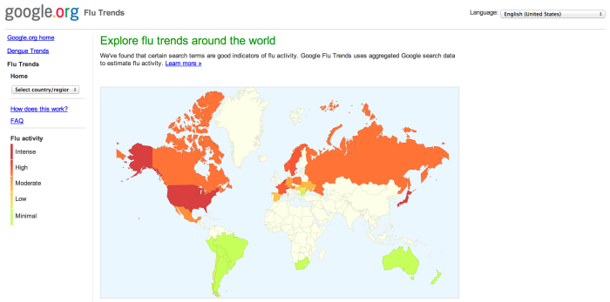
Why Data Mining? (Contd.)

Slide 11
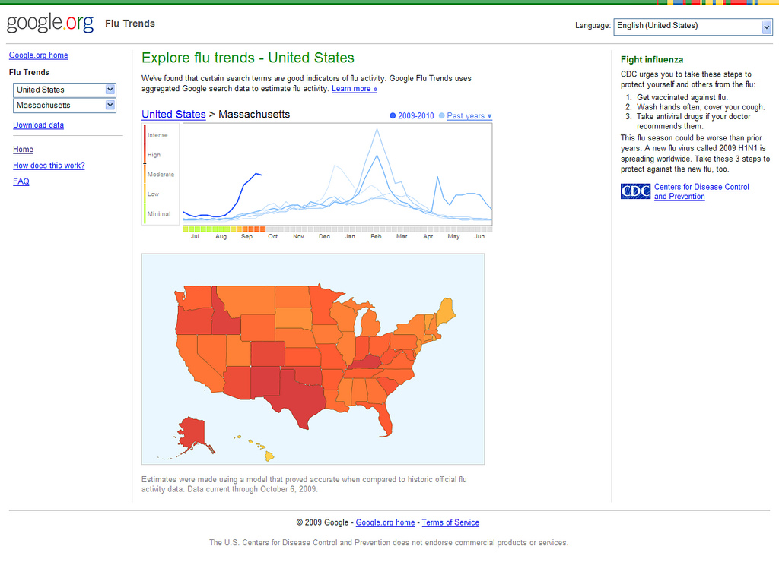
Why Data Mining? (Contd.)

Slide 12
What Kinds of Data can be Mined?
As a general technology, data mining can be applied to any kind of data as long as the data are meaningful for a target application.
The most basic forms of data for mining applications are as follows:
Database data
Data warehouse data
Transactional data
Data Mining can also be applied to other forms of data. For example: multimedia data, graph or networked data, and the WWW.

Slide 13
Data Warehouses
A data warehouse is a repository of information collected from multiple sources, stored under a unified schema, and usually residing at single site.
It is usually modeled by a multi-dimensional data structure, called a data cube, in which each dimension corresponds to an attribute or a set of attributes in the schema.
Each cell stores the value of sum aggregate measure such as count or sum.

Slide 14
Data Warehouses (Contd.)
Example:
We have a database that contains transaction information relating company sales of a part to a customer at a store location. The data cube formed from this database is a 3-dimensional representation, with each cell (p,c,s) of the cube representing a combination of values from part, customer and store-location.
The contents of each cell is the count of the number of times that specific combination of values occurs together in the database.
Cells that appear blank have a value of zero.
The cube can then be used to retrieve information within the database about, for example, which store should be given a certain part to sell in order to make the greatest sales.

Slide 15
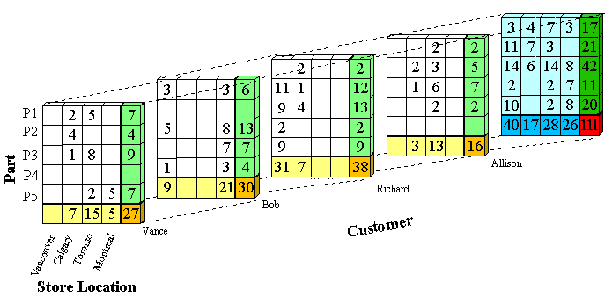
Data Warehouse (Contd.)

Slide 16
Regression
It is a statistical technique to determine the linear relationship between 2 or more variables
In its simplest form regression shows relationship between one independent variable (x) and a dependent variable (y)
Regression shows how variation in one variable co-occurs with variation in another.

Slide 17
Regression (Contd.)
The aim of the regression model is to find a slope and intercept so that the straight line with that slope and intercept fits the point in the scatter plot as closely as possible
Example:
Relationship between school percentage and college CGPA,
Relationship between advertising budgets and sales, etc.
The simple linear regression model is designed to study the relationship between a pair of variables that appear in the data set.

Slide 18
Classification
Classification can be defined as assigning an object to a certain class based on it similarity to previous examples of other objects
Example:
Classifying transactions as genuine or fraudulent
Credit card usage, insurance claims, cell phone calls
Degree of certainty associated with classification measures how closely the object resembles other examples from that class.

Slide 19
Classification (Contd.)
Techniques:
Non-Parametric: K-Nearest Neighbor
Mathematical Model: Neural Networks
Rule Based: Decision Trees

Slide 20
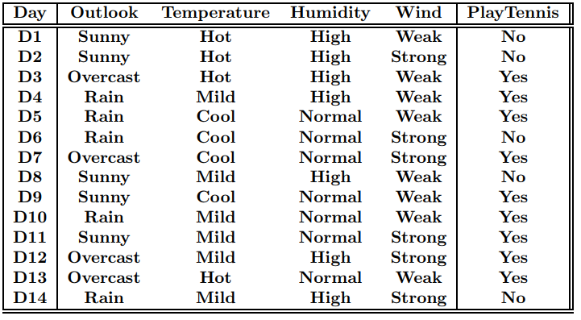
Classification (Contd.)
Decision Tree Example:

Slide 21
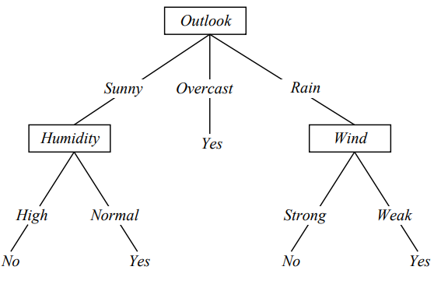
Classification (contd.)
Predict the value for: {Outlook = sunny, Temp = Cool, Humidity = High, Wind = Strong}

Slide 22
Association Rule Mining
It is used for finding patterns, associations, causal structure among set of items or objects in transaction databases, relational databases, etc.
Example:
Given: (1) Database of transactions (2) Each transaction is a list of items
Find: All rules that correlate the presence of one set of items with that of another set of items
98% of people who purchase tires and automotive accessories also get automotive services done.

Slide 23
Clustering
It organizes data into clusters
Used for finding groups of objects such that the objects in a group will be similar (or related) to one another and different from (or unrelated to) objects in other groups
Intra-cluster distances are minimized and inter-cluster distances are maximized.

Slide 24
Clustering (contd.)
Clustering algorithms can be applied in many fields, for example:
Marketing: Finding groups of customers with similar behavior given a large database of customer data containing their past buying records
Biology: Clustering of plants and animals given their features
WWW: Clustering weblog data to discover group of similar access patterns
Earthquake studies: clustering observed earthquake epicentres to identify dangerous zones

Slide 25
Data Visualization
Data Visualization aims to communicate data clearly and effectively through graphical representation
Visualization techniques can be used to discover data relationships that are otherwise not easily observed by looking at the raw data.
Techniques: Charts, graphs, plots (1- to n-dimensional), etc.
A good visualization should be effective, accurate and efficient.

Slide 26
Next Class
Data types and forms (numerical, categorical)
Importance of data pre-processing
Data Cleaning

